Slide 1
Chapter 8: Main Memory

Slide 2
Chapter 8: Memory Management
Background
Swapping (交换)
Contiguous Memory Allocation (连续内存分配)
Paging (分页)
Structure of the Page Table (页表结构)
Segmentation (分段)
Example: The Intel Pentium

Slide 3
Objectives
To provide a detailed description of various ways of organizing memory hardware
To discuss various memory-management techniques, including paging and segmentation
To provide a detailed description of the Intel Pentium, which supports both pure segmentation and segmentation with paging

Slide 4
Background
Program must be brought (from disk) into memory and placed within a process for it to be run
Main memory and registers are only storage CPU can access directly
Memory unit only sees a stream of addresses + read requests, or address + data and write requests
Register access in one CPU clock (or less)
Main memory can take many cycles
Cache sits between main memory and CPU registers
Protection of memory required to ensure correct operation

Slide 5
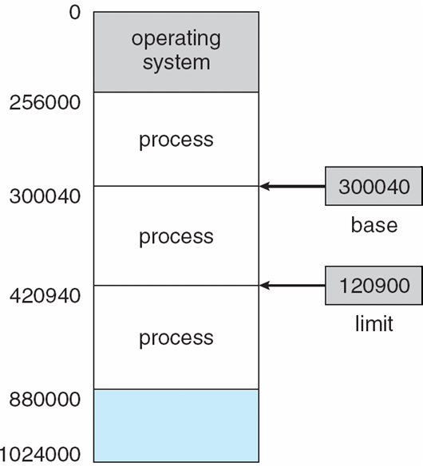
Base and Limit Registers
A pair of base and limit registers define the logical address space(地址空间)

Slide 6
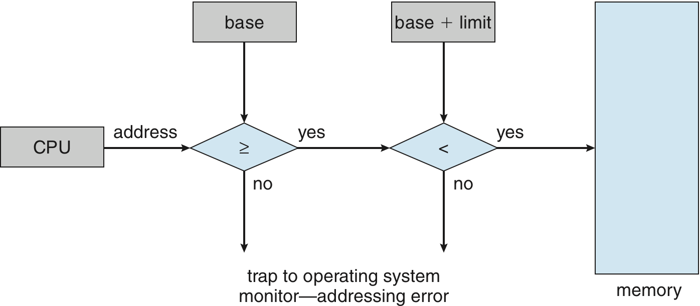
Hardware Address Protection with Base and Limit Registers

Slide 7
Address Binding(地址绑定)
Inconvenient to have first user process physical address always at 0000
How can it not be?
Further, addresses represented in different ways at different stages of a program’s life
Source code addresses usually symbolic
Compiled code addresses bind to relocatable(可重定位) addresses
i.e. “14 bytes from beginning of this module”
Linker or loader will bind relocatable addresses to absolute addresses
i.e. 74014
Each binding maps one address space to another

Slide 8
Binding of Instructions and Data to Memory
Address binding of instructions and data to memory addresses can happen at three different stages
Compile time(编译期): If memory location known a priori, absolute code can be generated; must recompile code if starting location changes
Load time(装入期): Must generate relocatable code if memory location is not known at compile time
Execution time(执行期): Binding delayed until run time if the process can be moved during its execution from one memory segment to another
Need hardware support for address maps (e.g., base and limit registers)

Slide 9
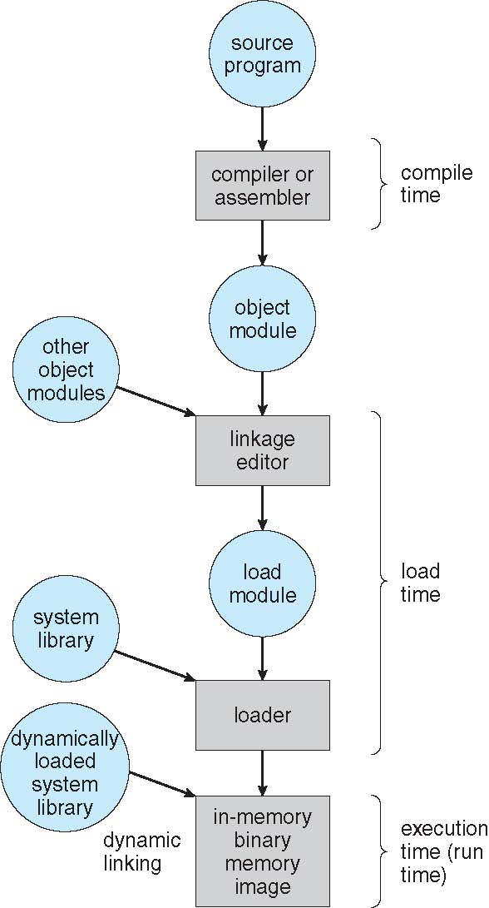
Multistep Processing of a User Program

Slide 10
Logical vs. Physical Address Space
The concept of a logical address space that is bound to a separate physical address space is central to proper memory management
Logical address(逻辑地址) – generated by the CPU; also referred to as virtual address(虚拟地址)
Physical address(物理地址) – address seen by the memory unit
Logical and physical addresses are the same in compile-time and load-time address-binding schemes; logical (virtual) and physical addresses differ in execution-time address-binding scheme
Logical address space(逻辑地址空间) is the set of all logical addresses generated by a program
Physical address space(物理地址空间) is the set of all physical addresses generated by a program

Slide 11
Memory-Management Unit (MMU)(内存管理单元)
Hardware device that at run time maps virtual to physical address
Many methods possible, covered in the rest of this chapter
To start, consider simple scheme where the value in the relocation register is added to every address generated by a user process at the time it is sent to memory
Base register now called relocation register(重定位寄存器)
MS-DOS on Intel 80x86 used 4 relocation registers
The user program deals with logical addresses; it never sees the real physical addresses
Execution-time binding occurs when reference is made to location in memory
Logical address bound to physical addresses

Slide 12
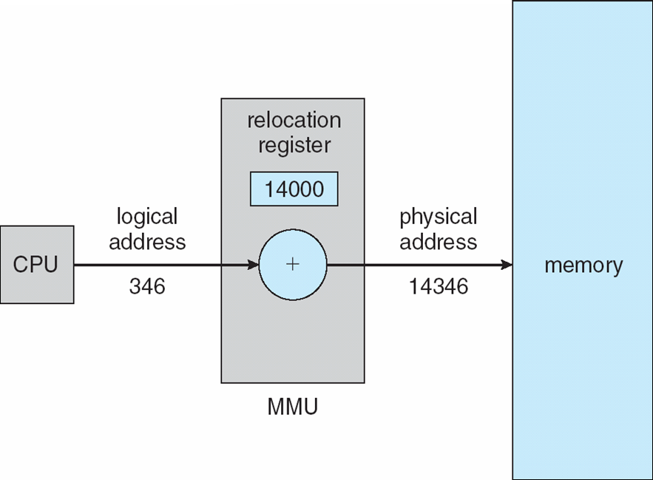
Dynamic relocation using a relocation register

Slide 13
Dynamic Loading(动态装入)
Routine is not loaded until it is called
Better memory-space utilization; unused routine is never loaded
All routines kept on disk in relocatable load format
Useful when large amounts of code are needed to handle infrequently occurring cases
No special support from the operating system is required
Implemented through program design
OS can help by providing libraries to implement dynamic loading

Slide 14
Dynamic Linking(动态链接)
Static linking(静态链接) – system libraries and program code combined by the loader into the binary program image
Dynamic linking –linking postponed until execution time
Small piece of code, stub(存根), used to locate the appropriate memory-resident library routine
Stub replaces itself with the address of the routine, and executes the routine
Operating system checks if routine is in processes’ memory address
If not in address space, add to address space
Dynamic linking is particularly useful for libraries
System also known as shared libraries(共享库)
Consider applicability to patching system libraries
Versioning may be needed

Slide 15
Swapping(交换)
A process can be swapped temporarily out of memory to a backing store, and then brought back into memory for continued execution
Total physical memory space of processes can exceed physical memory
Backing store – fast disk large enough to accommodate copies of all memory images for all users; must provide direct access to these memory images
Roll out, roll in – swapping variant used for priority-based scheduling algorithms; lower-priority process is swapped out so higher-priority process can be loaded and executed
Major part of swap time is transfer time; total transfer time is directly proportional to the amount of memory swapped
System maintains a ready queue of ready-to-run processes which have memory images on disk
Does the swapped out process need to swap back in to same physical addresses?
Depends on address binding method
Plus consider pending I/O to / from process memory space
Modified versions of swapping are found on many systems (i.e., UNIX, Linux, and Windows)
Swapping normally disabled
Started if more than threshold amount of memory allocated
Disabled again once memory demand reduced below threshold

Slide 16

Schematic View of Swapping

Slide 17
Context Switch Time including Swapping
If next processes to be put on CPU is not in memory, need to swap out a process and swap in target process
Context switch time can then be very high
100MB process swapping to hard disk with transfer rate of 50MB/sec
Plus disk latency of 8 ms
Swap out time of 2008 ms
Plus swap in of same sized process
Total context switch swapping component time of 4016ms (> 4 seconds)
Can reduce if reduce size of memory swapped – by knowing how much memory really being used
System calls to inform OS of memory use via request memory and release memory

Slide 18
Contiguous Allocation(连续内存分配)
Main memory usually into two partitions:
Resident operating system, usually held in low memory with interrupt vector
User processes then held in high memory
Each process contained in single contiguous section of memory
Relocation registers used to protect user processes from each other, and from changing operating-system code and data
Base register contains value of smallest physical address
Limit register contains range of logical addresses – each logical address must be less than the limit register
MMU maps logical address dynamically
Can then allow actions such as kernel code being transient and kernel changing size

Slide 19

Hardware Support for Relocation and Limit Registers

Slide 20
Contiguous Allocation (Cont.)
Multiple-partition allocation
Degree of multiprogramming limited by number of partitions
Hole – block of available memory; holes of various size are scattered throughout memory
When a process arrives, it is allocated memory from a hole large enough to accommodate it
Process exiting frees its partition, adjacent free partitions combined
Operating system maintains information about: a) allocated partitions b) free partitions (hole)
OS
OS
OS
OS
process 5
process 5
process 5
process 5
process 9
process 9
process 8
process 10
process 2
process 2
process 2
process 2

Slide 21
Dynamic Storage-Allocation Problem
How to satisfy a request of size n from a list of free holes?
First-fit(首次适应): Allocate the first hole that is big enough
Best-fit(最佳适应): Allocate the smallest hole that is big enough; must search entire list, unless ordered by size
Produces the smallest leftover hole
Worst-fit(最坏适应): Allocate the largest hole; must also search entire list
Produces the largest leftover hole
First-fit and best-fit better than worst-fit in terms of speed and storage utilization

Slide 22
Fragmentation(碎片)
External Fragmentation(外部碎片) – total memory space exists to satisfy a request, but it is not contiguous
Internal Fragmentation(内部碎片) – allocated memory may be slightly larger than requested memory; this size difference is memory internal to a partition, but not being used
First fit analysis reveals that given N blocks allocated, 0.5 N blocks lost to fragmentation
1/3 may be unusable -> 50-percent rule

Slide 23
Fragmentation (Cont.)
Reduce external fragmentation by compaction(内存紧缩)
Shuffle memory contents to place all free memory together in one large block
Compaction is possible only if relocation is dynamic, and is done at execution time
I/O problem
Latch job in memory while it is involved in I/O
Do I/O only into OS buffers
Now consider that backing store has same fragmentation problems

Slide 24
Paging
Physical address space of a process can be noncontiguous; process is allocated physical memory whenever the latter is available
Divide physical memory into fixed-sized blocks called frames(帧/块)
Size is power of 2, between 512 bytes and 16 Mbytes
Divide logical memory into blocks of same size called pages(页)
Keep track of all free frames
To run a program of size N pages, need to find N free frames and load program
Set up a page table(页表) to translate logical to physical addresses
Backing store likewise split into pages
Still have Internal fragmentation

Slide 25
Address Translation Scheme
Address generated by CPU is divided into:
Page number (p) – used as an index into a page table which contains base address of each page in physical memory
Page offset (d) – combined with base address to define the physical memory address that is sent to the memory unit
For given logical address space 2^{m} and page size 2^{n}
page number
page offset
p
d
m - n
n

Slide 26
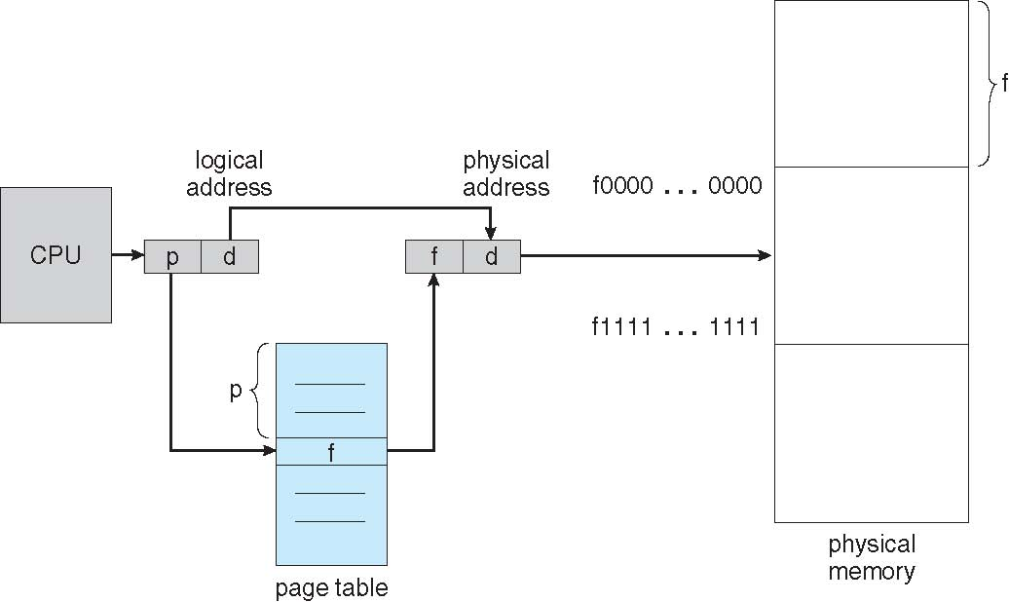
Paging Hardware

Slide 27

Paging Model of Logical and Physical Memory

Slide 28

Paging Example
n=2 and m=4 32-byte memory and 4-byte pages

Slide 29
Paging (Cont.)
Calculating internal fragmentation
Page size = 2,048 bytes
Process size = 72,766 bytes
35 pages + 1,086 bytes
Internal fragmentation of 2,048 - 1,086 = 962 bytes
Worst case fragmentation = 1 frame – 1 byte
On average fragmentation = 1 / 2 frame size
So small frame sizes desirable?
But each page table entry takes memory to track
Page sizes growing over time
Solaris supports two page sizes – 8 KB and 4 MB
Process view and physical memory now very different
By implementation process can only access its own memory

Slide 30

Free Frames
Before allocation
After allocation

Slide 31
Implementation of Page Table
Page table is kept in main memory
Page-table base register (PTBR) points to the page table
Page-table length register (PTLR) indicates size of the page table
In this scheme every data/instruction access requires two memory accesses
One for the page table and one for the data / instruction
The two memory access problem can be solved by the use of a special fast-lookup hardware cache called associative memory or translation look-aside buffers (TLBs)(页表缓存)
Some TLBs store address-space identifiers (ASIDs) in each TLB entry – uniquely identifies each process to provide address-space protection for that process
Otherwise need to flush at every context switch
TLBs typically small (64 to 1,024 entries)
On a TLB miss, value is loaded into the TLB for faster access next time
Replacement policies must be considered
Some entries can be wired down for permanent fast access

Slide 32
Associative Memory
Associative memory – parallel search
Address translation (p, d)
If p is in associative register, get frame # out
Otherwise get frame # from page table in memory
Page #
Frame #

Slide 33

Paging Hardware With TLB

Slide 34
Effective Access Time
Associative Lookup = ε time unit
Can be < 10% of memory access time
Hit ratio = α
Hit ratio – percentage of times that a page number is found in the associative registers; ratio related to number of associative registers
Consider α = 80%, ε = 20ns for TLB search, 100ns for memory access
Effective Access Time (EAT)
EAT = (1 + ε) α + (2 + ε)(1 – α)
= 2 + ε – α
Consider α = 80%, ε = 20ns for TLB search, 100ns for memory access
EAT = 0.80 x 120 + 0.20 x 220 = 140ns
Consider slower memory but better hit ratio -> α = 98%, ε = 20ns for TLB search, 140ns for memory access
EAT = 0.98 x 160 + 0.02 x 300 = 162.8ns

Slide 35
Memory Protection
Memory protection implemented by associating protection bit with each frame to indicate if read-only or read-write access is allowed
Can also add more bits to indicate page execute-only, and so on
Valid-invalid(有效无效位) bit attached to each entry in the page table:
“valid” indicates that the associated page is in the process’ logical address space, and is thus a legal page
“invalid” indicates that the page is not in the process’ logical address space
Or use PTLR
Any violations result in a trap to the kernel

Slide 36

Valid (v) or Invalid (i) Bit In A Page Table

Slide 37
Shared Pages(共享页)
Shared code
One copy of read-only (reentrant) code shared among processes (i.e., text editors, compilers, window systems)
Similar to multiple threads sharing the same process space
Also useful for interprocess communication if sharing of read-write pages is allowed
Private code and data
Each process keeps a separate copy of the code and data
The pages for the private code and data can appear anywhere in the logical address space

Slide 38
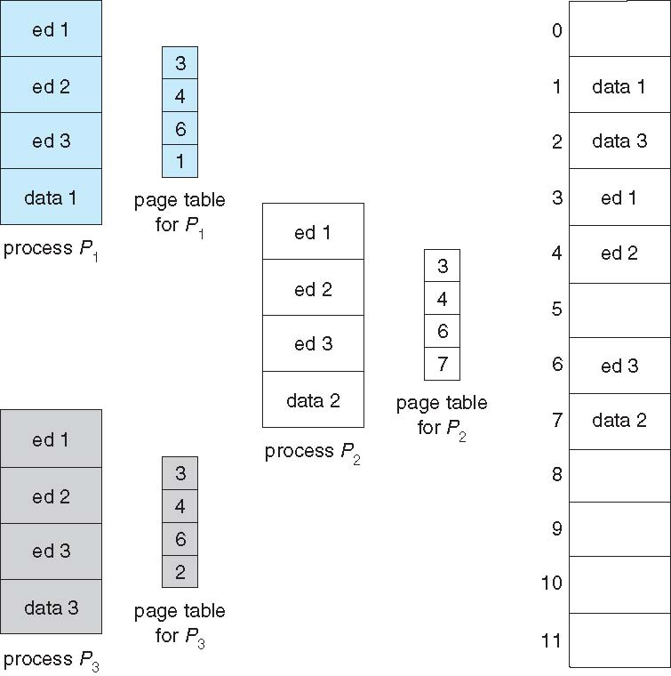
Shared Pages Example

Slide 39
Structure of the Page Table
Memory structures for paging can get huge using straight-forward methods
Consider a 32-bit logical address space as on modern computers
Page size of 4 KB (2¹²)
Page table would have 1 million entries (2³² / 2¹²⁾
If each entry is 4 bytes -> 4 MB of physical address space / memory for page table alone
That amount of memory used to cost a lot
Don’t want to allocate that contiguously in main memory
Hierarchical Paging
Hashed Page Tables
Inverted Page Tables

Slide 40
Hierarchical Page Tables
Break up the logical address space into multiple page tables
A simple technique is a two-level page table
We then page the page table

Slide 41

Two-Level Page-Table Scheme

Slide 42
Two-Level Paging Example
A logical address (on 32-bit machine with 1K page size) is divided into:
a page number consisting of 22 bits
a page offset consisting of 10 bits
Since the page table is paged, the page number is further divided into:
a 12-bit page number
a 10-bit page offset
Thus, a logical address is as follows:
where p₁ is an index into the outer page table, and p₂ is the displacement within the page of the inner page table
Known as forward-mapped page table
page number
page offset
p₁
p₂
d
12
10
10

Slide 43

Address-Translation Scheme

Slide 44
64-bit Logical Address Space
Even two-level paging scheme not sufficient
If page size is 4 KB (2¹²)
Then page table has 2⁵² entries
If two level scheme, inner page tables could be 2¹⁰ 4-byte entries
Address would look like
Outer page table has 2⁴² entries or 2⁴⁴ bytes
One solution is to add a 2nd outer page table
But in the following example the 2nd outer page table is still 2³⁴ bytes in size
And possibly 4 memory access to get to one physical memory location
outer
inner
page offset
p₁
p₂
d
42
10
12

Slide 45


Three-level Paging Scheme

Slide 46
Hashed Page Tables
Common in address spaces > 32 bits
The virtual page number is hashed into a page table
This page table contains a chain of elements hashing to the same location
Each element contains (1) the virtual page number (2) the value of the mapped page frame (3) a pointer to the next element
Virtual page numbers are compared in this chain searching for a match
If a match is found, the corresponding physical frame is extracted

Slide 47

Hashed Page Table

Slide 48
Inverted Page Table(反置页表)
Rather than each process having a page table and keeping track of all possible logical pages, track all physical pages
One entry for each real page of memory
Entry consists of the virtual address of the page stored in that real memory location, with information about the process that owns that page
Decreases memory needed to store each page table, but increases time needed to search the table when a page reference occurs
Use hash table to limit the search to one — or at most a few — page-table entries
TLB can accelerate access
But how to implement shared memory?
One mapping of a virtual address to the shared physical address

Slide 49

Inverted Page Table Architecture

Slide 50
Segmentation(分段)
Memory-management scheme that supports user view of memory
A program is a collection of segments
A segment is a logical unit such as:
main program
procedure
function
method
object
local variables, global variables
common block
stack
symbol table
arrays

Slide 51
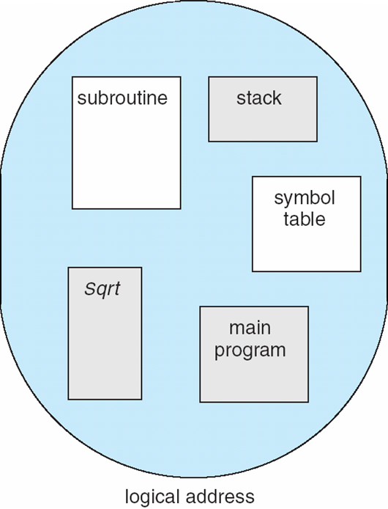
User’s View of a Program

Slide 52
Logical View of Segmentation
1
1
4
2
3
4
2
3
user space
physical memory space

Slide 53
Segmentation Architecture
Logical address consists of a two tuple:
<segment-number, offset>,
Segment table – maps two-dimensional physical addresses; each table entry has:
base – contains the starting physical address where the segments reside in memory
limit – specifies the length of the segment
Segment-table base register (STBR) points to the segment table’s location in memory
Segment-table length register (STLR) indicates number of segments used by a program;
segment number s is legal if s < STLR

Slide 54
Segmentation Architecture (Cont.)
Protection
With each entry in segment table associate:
validation bit = 0 ⇒ illegal segment
read/write/execute privileges
Protection bits associated with segments; code sharing occurs at segment level
Since segments vary in length, memory allocation is a dynamic storage-allocation problem
A segmentation example is shown in the following diagram

Slide 55
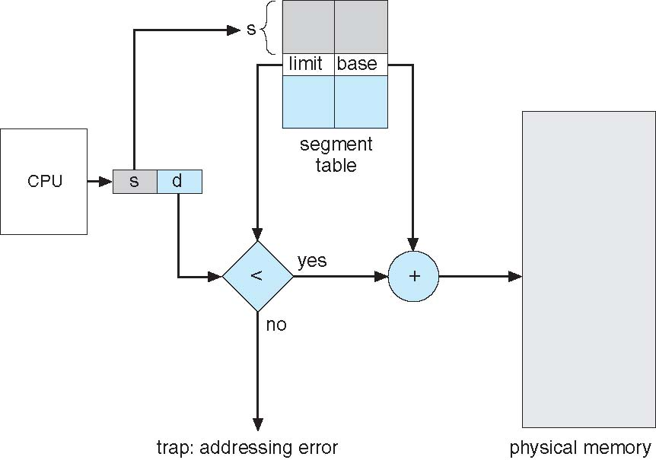
Segmentation Hardware

Slide 56
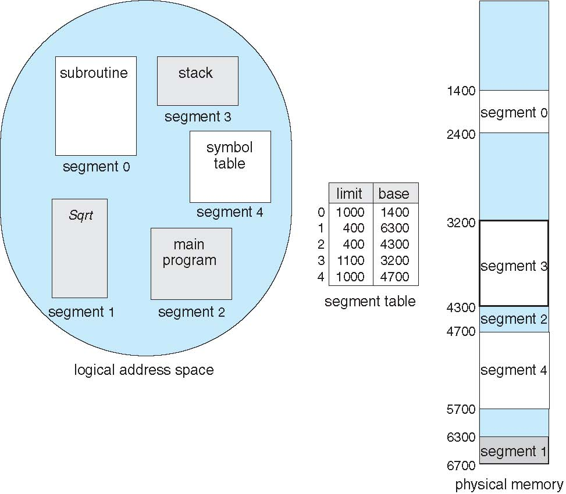
Example of Segmentation

Slide 57
Example: The Intel Pentium
Supports both segmentation and segmentation with paging
Each segment can be 4 GB
Up to 16 K segments per process
Divided into two partitions
First partition of up to 8 K segments are private to process (kept in local descriptor table LDT)
Second partition of up to 8K segments shared among all processes (kept in global descriptor table GDT)
CPU generates logical address
Given to segmentation unit
Which produces linear addresses
Linear address given to paging unit
Which generates physical address in main memory
Paging units form equivalent of MMU
Pages sizes can be 4 KB or 4 MB

Slide 58
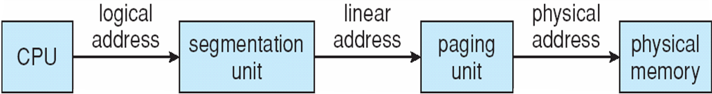
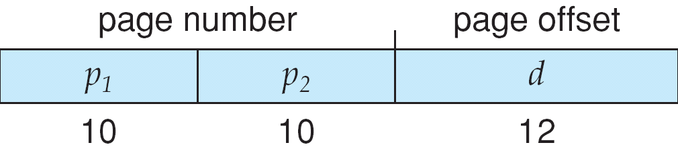
Logical to Physical Address Translation in Pentium

Slide 59
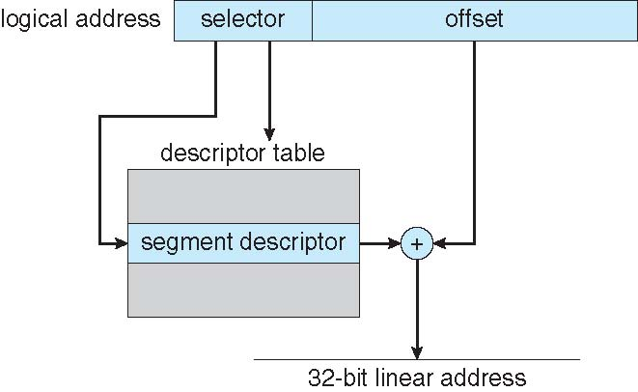
Intel Pentium Segmentation

Slide 60
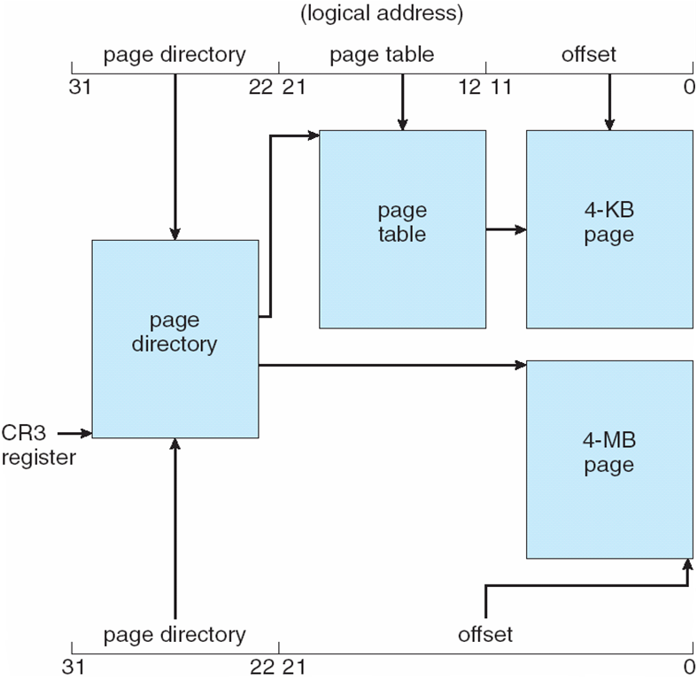
Pentium Paging Architecture

Slide 61

Linear Address in Linux
Linux uses only 6 segments (kernel code, kernel data, user code, user data, task-state segment (TSS), default LDT segment)
Linux only uses two of four possible modes – kernel and user
Uses a three-level paging strategy that works well for 32-bit and 64-bit systems
Linear address broken into four parts:
But the Pentium only supports 2-level paging?!

Slide 62
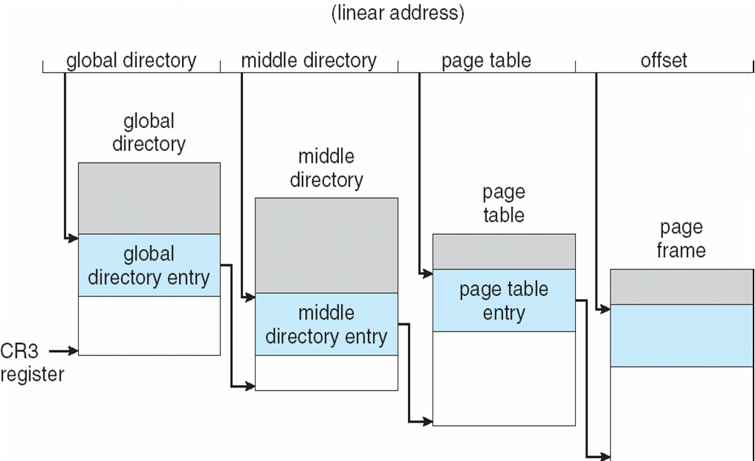
Three-level Paging in Linux

Slide 63
End of Chapter 7

